Slide 1
Movie Recommendation System
Project by,
Supreeth
Raghuveer
Srikanth
Suhas
Social Media Mining

Slide 2
Motivation
Current social media platforms use their own domain data to recommend related movies or videos.
Our aim is to develop a more robust platform that retrieves cross domain data under a single roof.
Social Media Mining

Slide 3
Design
YouTube
Comments
Web Application
Sentiment Analyzer
MySQL DB
IMDB
Social Media Mining

Slide 4
Design
Retrieved users’ YouTube comments.
Built a suitable data model by enriching the data.
Developed a sentiment classifier to predict user ratings.
Retrieved movies related to users’ favorite genre from IMDB.
Interactive web application to visualize the results.
Social Media Mining

Slide 5
Data
Mined 1000 YouTube comments collectively from 10 users.
Mined 500 IMDB movies for top 10 genres.
Created User, Video, Movie and Rating tables.
Used MySQL for data storage.
Social Media Mining

Slide 6
Implementation
Used YouTube Data API to retrieve video ID and user comments
Imported positive and negative WordNet files
Assigned weightage to each word based on its intensity
Developed sentiment classifier which predicts positive and negative score for each comment
Social Media Mining

Slide 7
Implementation contd..
Based on the percentage of positive score, we calculate ratings on a scale of 0-5 with 5 being highly positive comment and 0 being highly negative comment.
For a particular user, we pick the genres where users’ rating is the highest and display similar YouTube videos and top rated IMDB movies.
Social Media Mining

Slide 8
Implementation contd..
We built an interactive web application using PHP.
User is first authenticated and when the login is successful, we recommend new YouTube videos and IMDB movies of users’ interest.
User can watch YouTube videos on the go or click on the movie link which redirects to corresponding IMBD page.
Social Media Mining

Slide 9
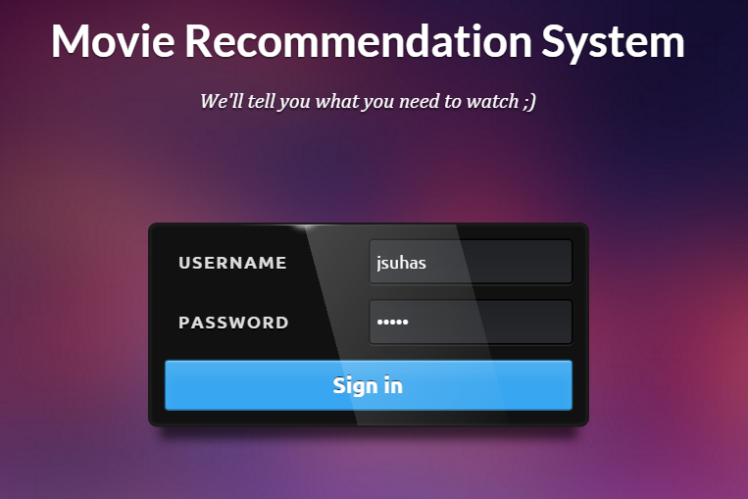
Visualization
Social Media Mining

Slide 10
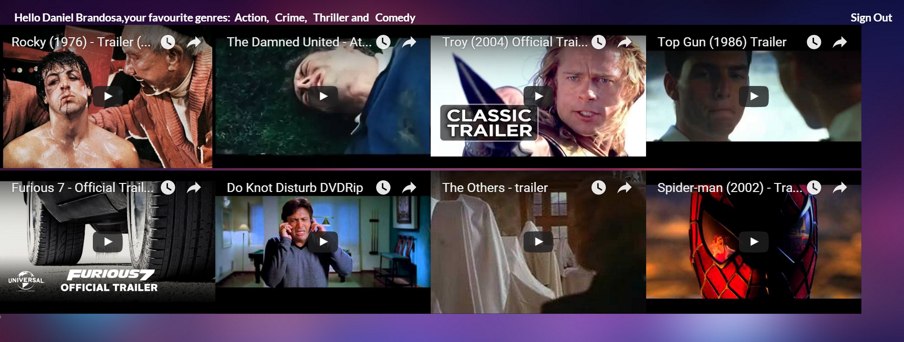

Visualization contd..
Social Media Mining

Slide 11
Future enhancements
Increase the size of the dataset.
Build a much stronger sentiment classifier to detect sarcastic comments.
New user registration.
Dynamically pick videos from YouTube when user logs in.
Social Media Mining

Slide 12

Confused what to watch this weekend?
Social Media Mining

